Slide 1
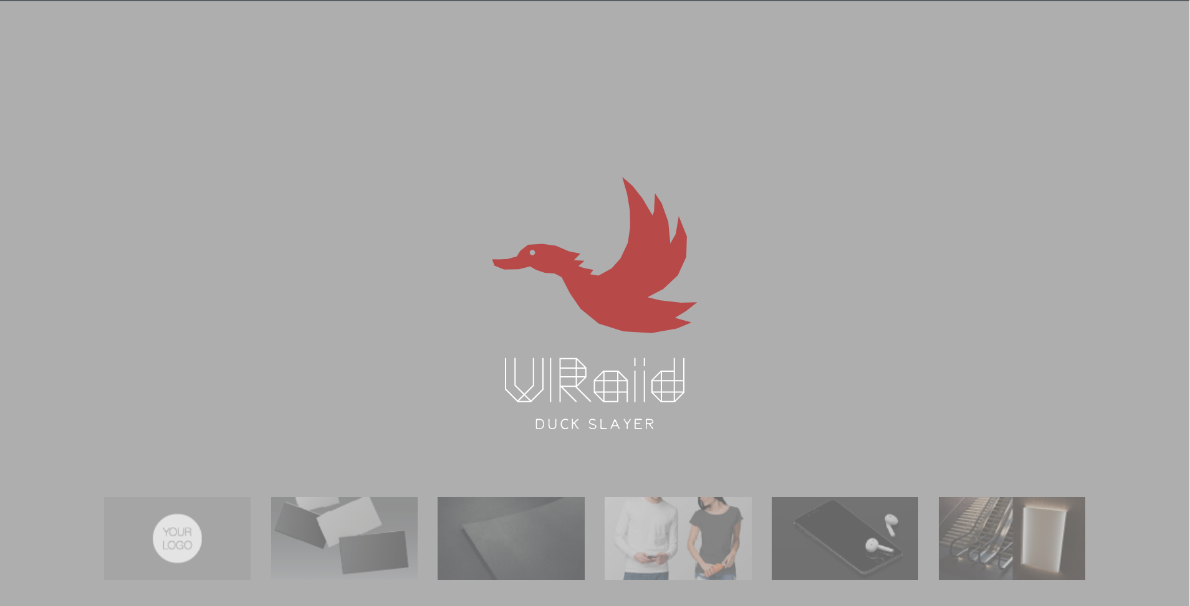

Slide 2
Inspiration
Duck hunt game of old days
Nostalgia mixed with a new environment
VR development as itself

Slide 3
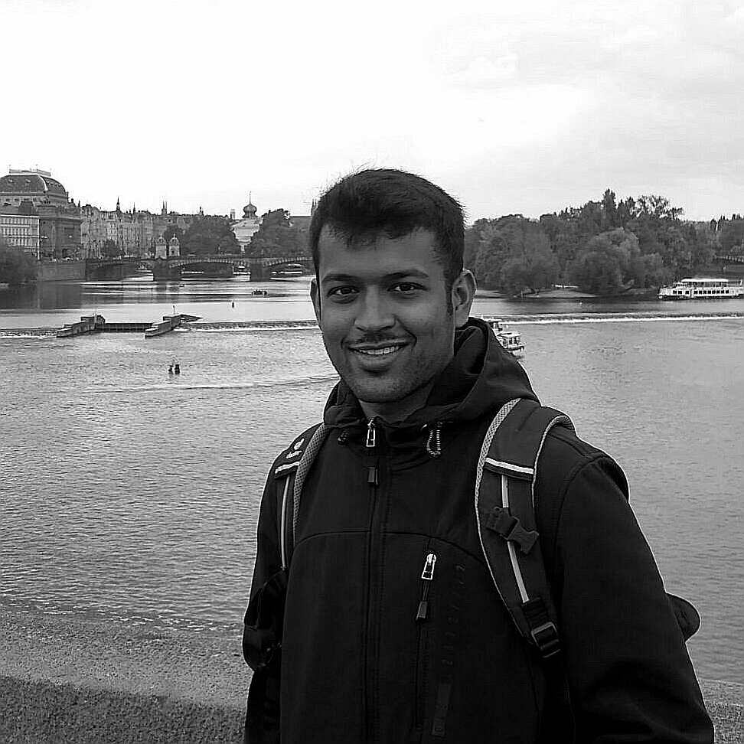
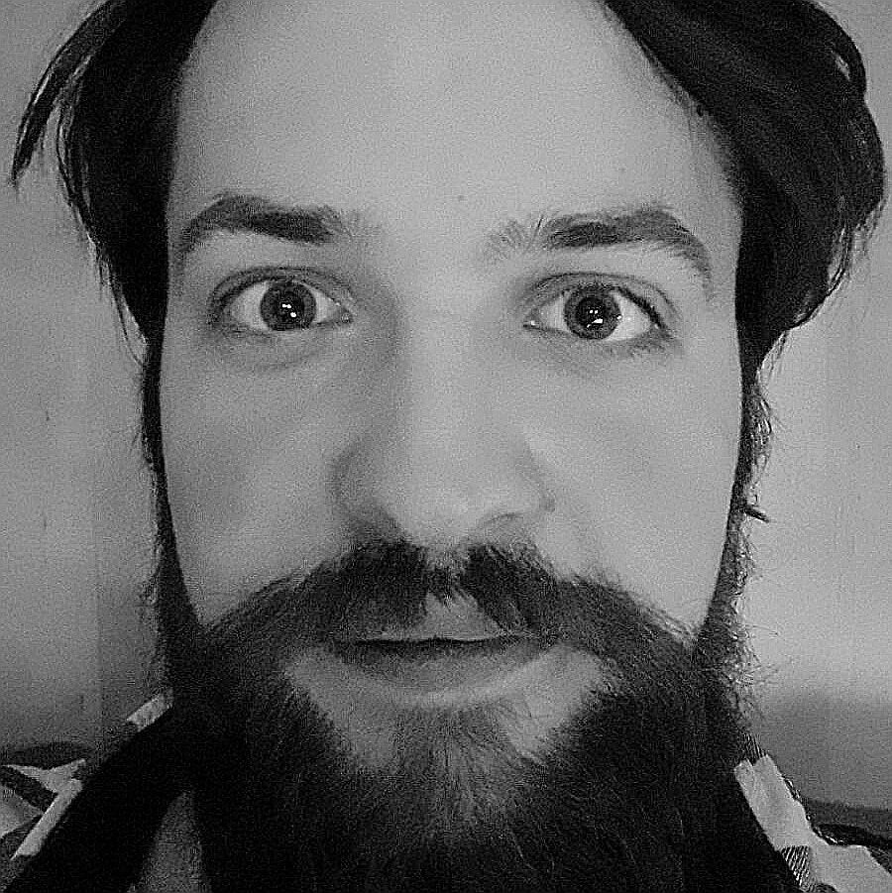
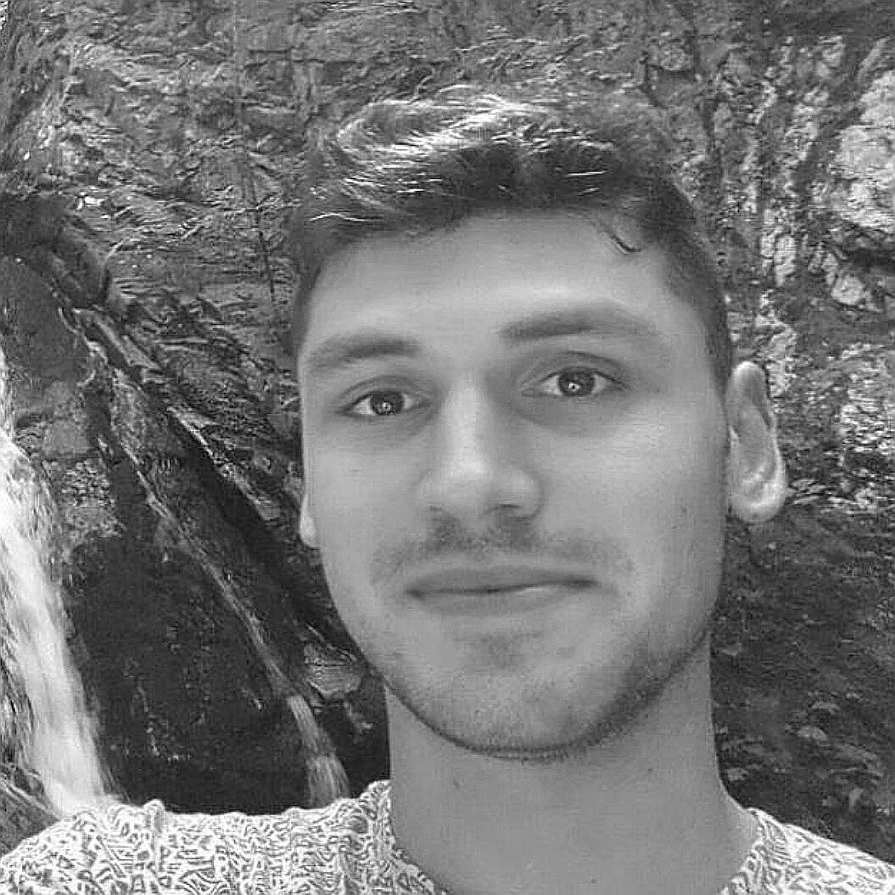
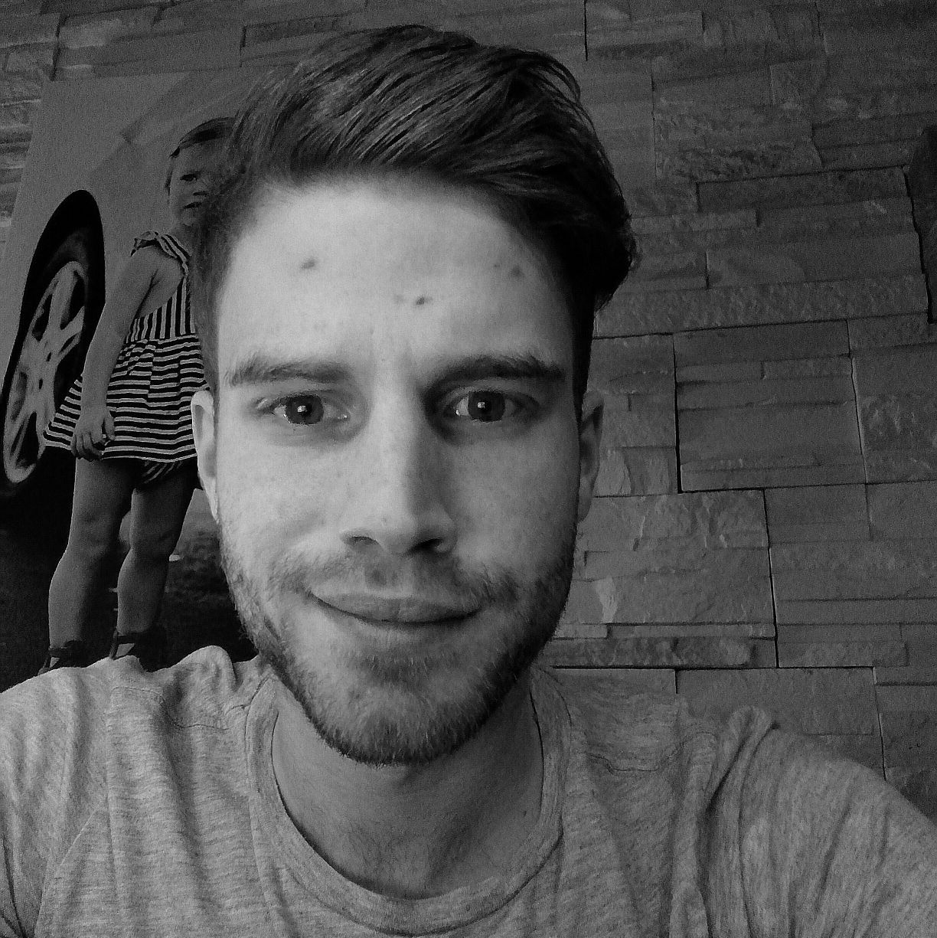
The Team
Programmer #1
Design
Harsh Kedia
M. Sc. Informatics
University of Konstanz
Daniel Sviták
MgA Architecture
UMPRUM
Programmer #1
Organization & Communication
Kliment Sokolov
M. Sc. Informatics
University of Konstanz
Timo Copp
M. Sc. Informatics
OTH Regensburg

Slide 4
What did we do Harsh Kedia & Kliment Sokolov
Backend programming
Scene modelling
Physics adjustment
Polishing
Testing

Slide 5
What did we do Daniel Sviták
Duck & weapon modelling
Scene adjustments

Slide 6
What did we do Timo Copp
GDD, Presentations & Communication
Web Design
Scene Modelling

Slide 7
Challenges with VR
Controller Indexing
Physic Adjustments
3D-Sounds
Limiting the scenes

Slide 8
See what we got
https://hkedia.github.io/VRaid/

